Slide 1
Fleet Management
Group 3: Paula Arroyave, James Blair, Faiza Hoque, Drake Lam, Nicole Lenge, Matt Machado, and Corinne Scheddin

Slide 2
Goal of Our Database
Improve TCNJ fleet financially and environmentally
Identify current fleet metrics and outline potential future fleet combinations
Answer various queries to aid understanding of TCNJ’s vehicle fleet
Notes:
ACC student
Corinne

Slide 3
Questions our Database Should Answers
What kind of fuel does each type of vehicle use and what are its emission?
What are the financial costs of each type of vehicle?
What are the specifications of each vehicle in terms of vehicle type, model, and usage?
What is the age, department, and year of each vehicle currently in the fleet?
What is the proposed and future course of action concerning each vehicle in the fleet?
Notes:
Drake - ACC Student

Slide 4
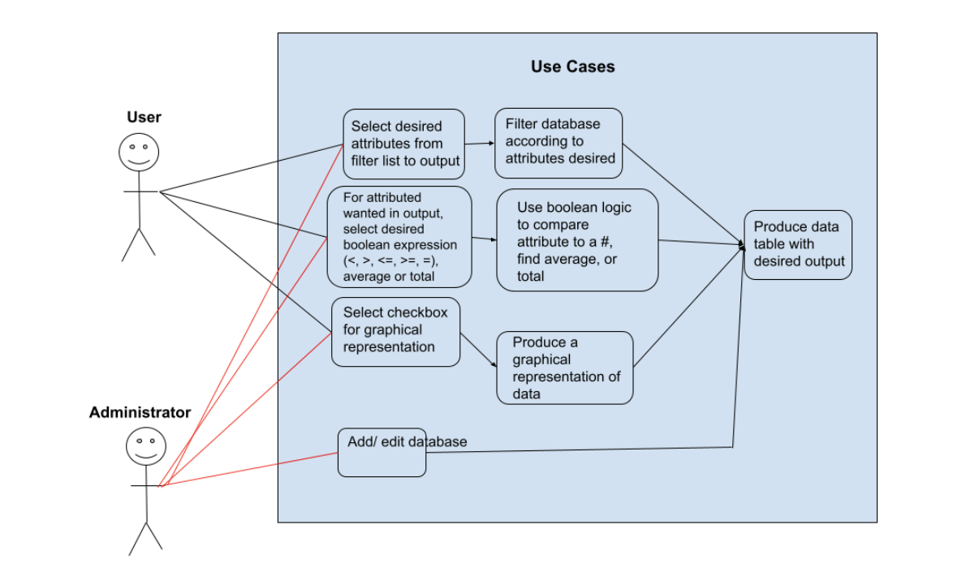
User Cases
Notes:
CS Student

Slide 5
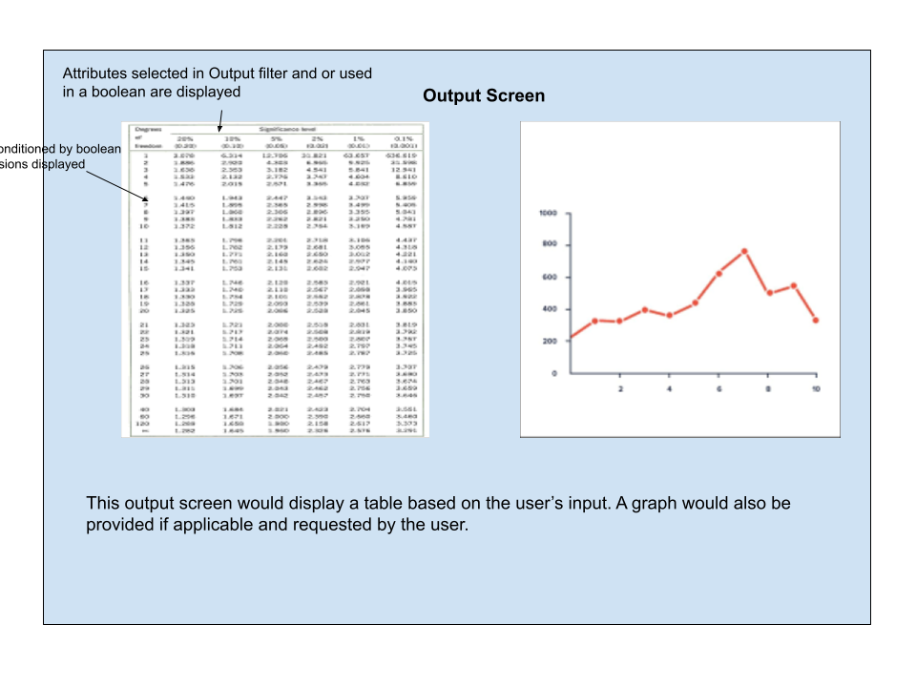
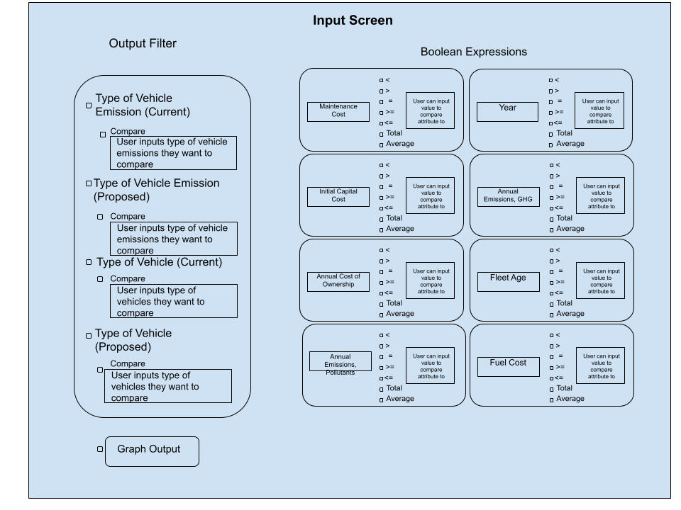
User Views
Notes:
CS Student

Slide 6
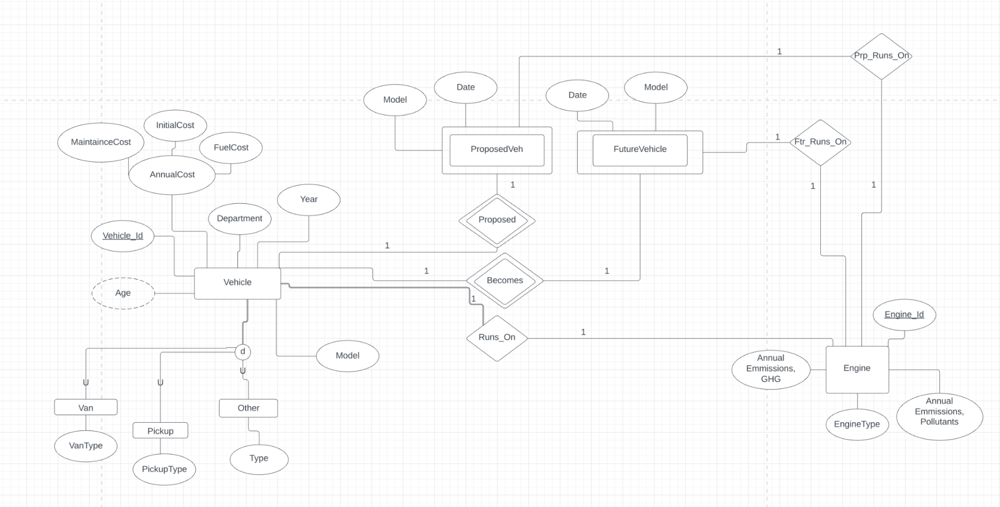
ER Diagram
Notes:
CS Student

Slide 7
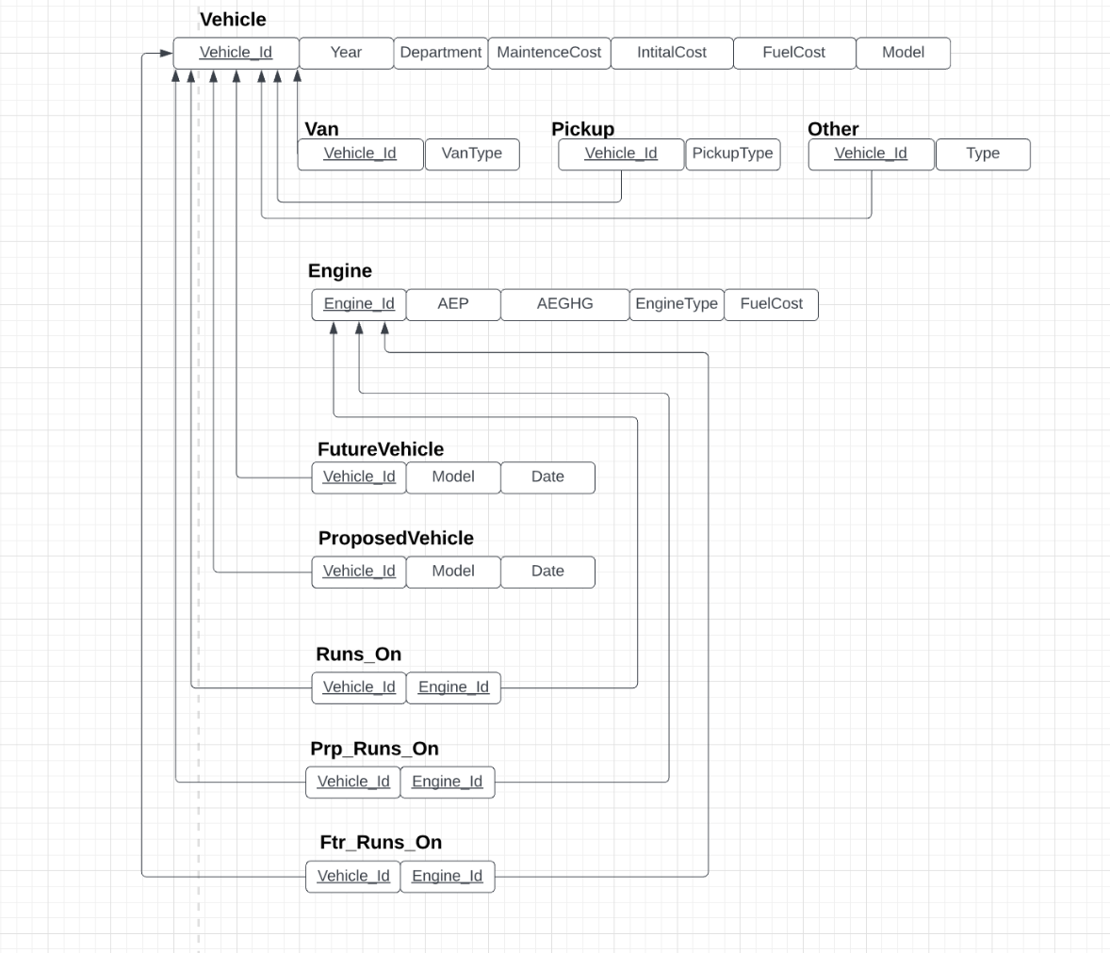
Relational Schema

Slide 8
Database Details
Our database should be able to support about 200 entries since there about 100 vehicles in TCNJ’s fleet and some may and go.
Our types of queries would be select and action queries:
Select queries: focus on retrieving information from the database to answer a question the user may have
Action queries: an administrative user would be able to insert, delete, and update the data in our database

